Slide 1

ONLINE FOOD ORDERING APP PROJECT WITH MERN STACK
Student Name:
Bharath Sai Veeragoni
Student ID:
21C45A0507
College Name:
Jayamukhi Institute Of Technological Sciences

Slide 2
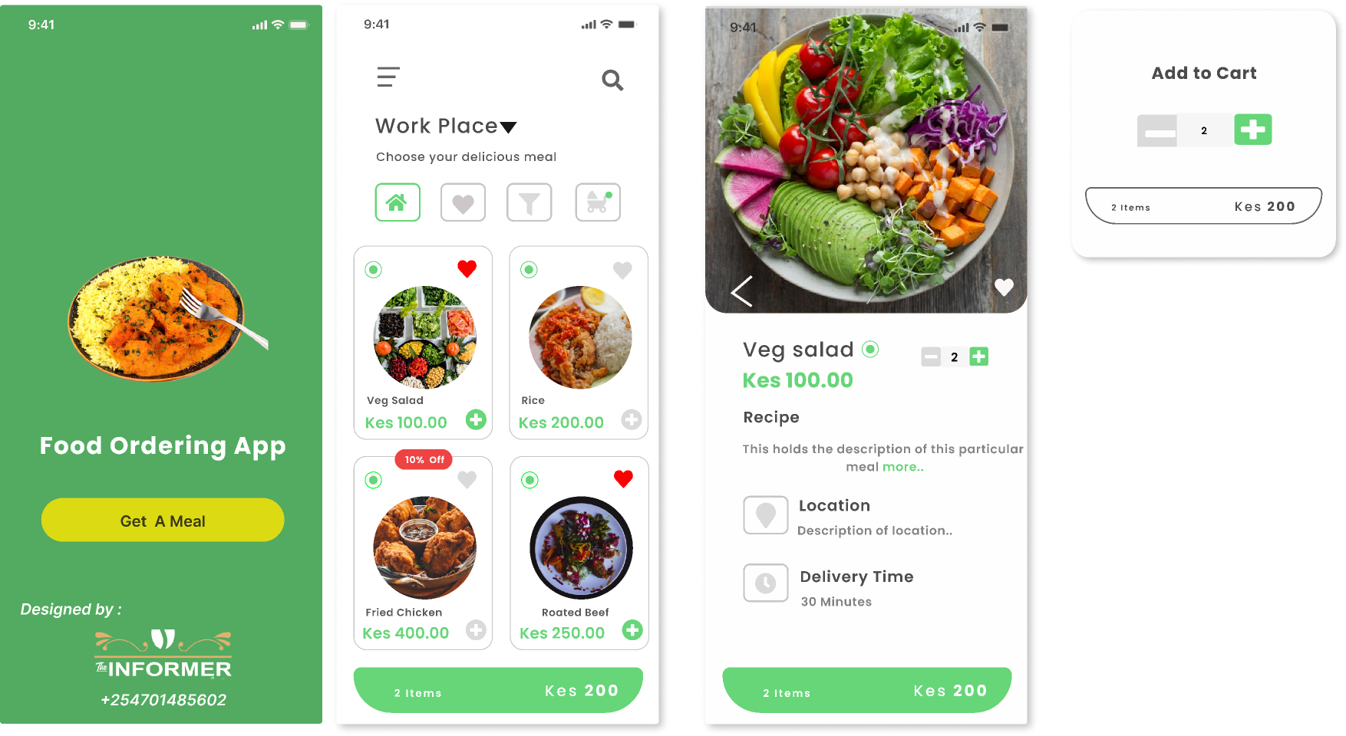
ABSTRACT
The Food Ordering App is a convenient and user-friendly platform designed to streamline the process of ordering food from local restaurants. With an intuitive interface, it allows users to browse menus, customize their orders, and make secure payments—all from their mobile/laptop devices. The app integrates real-time tracking, providing customers with updates on the status of their orders, including estimated delivery times. Additionally, it offers features like personalized recommendations, user reviews, and promotions, enhancing the overall experience. The app also supports restaurant management by allowing easy menu updates, order management, and customer feedback analysis. Ultimately, the Food Ordering App aims to deliver an efficient and seamless food ordering experience, saving time for customers and increasing sales for restaurants.

Slide 3
Problem Statement
In today's fast-paced world, ordering food can be a time-consuming and inefficient process.
Customers often face issues such as limited access to restaurant menus, lack of personalization, long wait times, and poor communication between restaurants and customers.
Additionally, many restaurants struggle with managing orders, tracking deliveries, and providing a seamless customer experience.
Traditional food ordering methods, such as phone calls or in-person ordering, can be cumbersome and prone to errors.
There is a need for a solution that simplifies the entire food ordering process for customers and streamlines operations for restaurants.

Slide 4

Proposed Solution
The proposed solution is an Online Food Ordering App designed to enhance the user experience and improve restaurant operations. The app will provide customers with an easy-to-use platform to browse a wide range of restaurant menus, place orders, customize their meals, and make secure payments—all from their smartphones. Key features include:
User Personalization: The app will use customer preferences, previous orders, and location data to recommend relevant restaurants and dishes.
Real-Time Tracking: Customers can track their orders in real time, receiving updates on order preparation, cooking, and delivery status.
Restaurant Management: The app will allow restaurants to efficiently manage their orders, update menus, set delivery times, and handle customer feedback.
Secure Payments: Multiple payment options, including credit/debit cards, digital wallets, and cash on delivery, will ensure secure and seamless transactions.
Customer Reviews and Ratings: Users can rate and review restaurants, which helps build trust and provides feedback to improve services.
Promotions and Discounts: The app will include promotional offers and discounts to encourage repeat customers and boost sales.

Slide 5
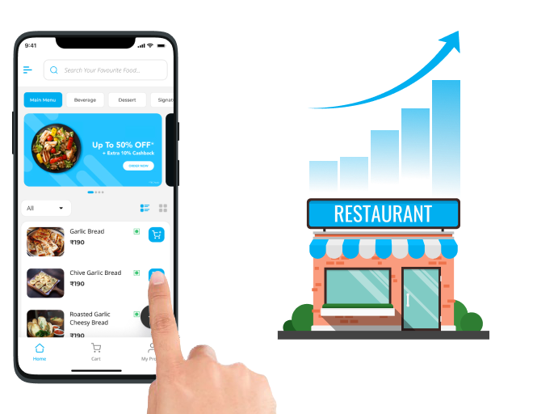
Project Overview
The Online Food Ordering App is a web-based application designed to provide users with a seamless and efficient way to order food from various restaurants. Built using the MERN stack (MongoDB, Express.js, React, Node.js), the app will provide users with a modern, scalable, and secure platform that makes ordering food easy, fast, and enjoyable. The app allows users to browse restaurant menus, customize orders, pay securely, and track deliveries in real-time.
Key Features:
User Authentication: Users can sign up, log in, and manage their profiles securely. Authentication and authorization are handled using JWT (JSON Web Tokens) for a smooth user experience.
Restaurant Menu: Restaurants can list their menus with categories (e.g., veg, non-veg, desserts) and offer filtering options based on cuisine, price, and ratings..
Real-Time Order Tracking: Once an order is placed, users can track their orders in real-time from preparation to delivery. Notifications will update users on the status of their order.
Payment Integration: The app supports secure payment options such as credit/debit cards and digital wallets through third-party payment gateways like Stripe or PayPal.
Admin Dashboard: A backend dashboard for restaurant owners and administrators to manage orders, update the menu, track delivery progress, and view analytics on sales and user activity.
Search and Filters: Users can search for restaurants and dishes based on location, cuisine type, price, ratings, and other criteria.
Responsive Design: The app is designed to be fully responsive, providing an optimized experience across different devices like smartphones, tablets, and desktops.

Slide 6
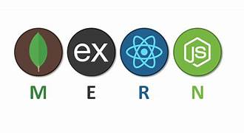
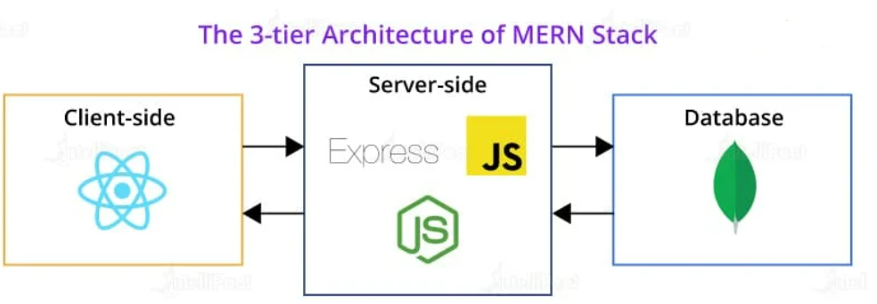
Technologies Used
Frontend: The React app handles user interactions, rendering menus, managing orders, and showing real-time updates. React's component-based architecture ensures maintainability and scalability.
Backend: The Node.js server using Express.js handles the business logic, API requests, user authentication, order processing, and payment transactions. It communicates with the MongoDB database to store user data, restaurant menus, orders, and reviews.
Database: MongoDB is used for its scalability and flexibility to handle dynamic data such as user profiles, menus, orders, and reviews.
API: RESTful APIs are used to facilitate communication between the frontend and backend.

Slide 7
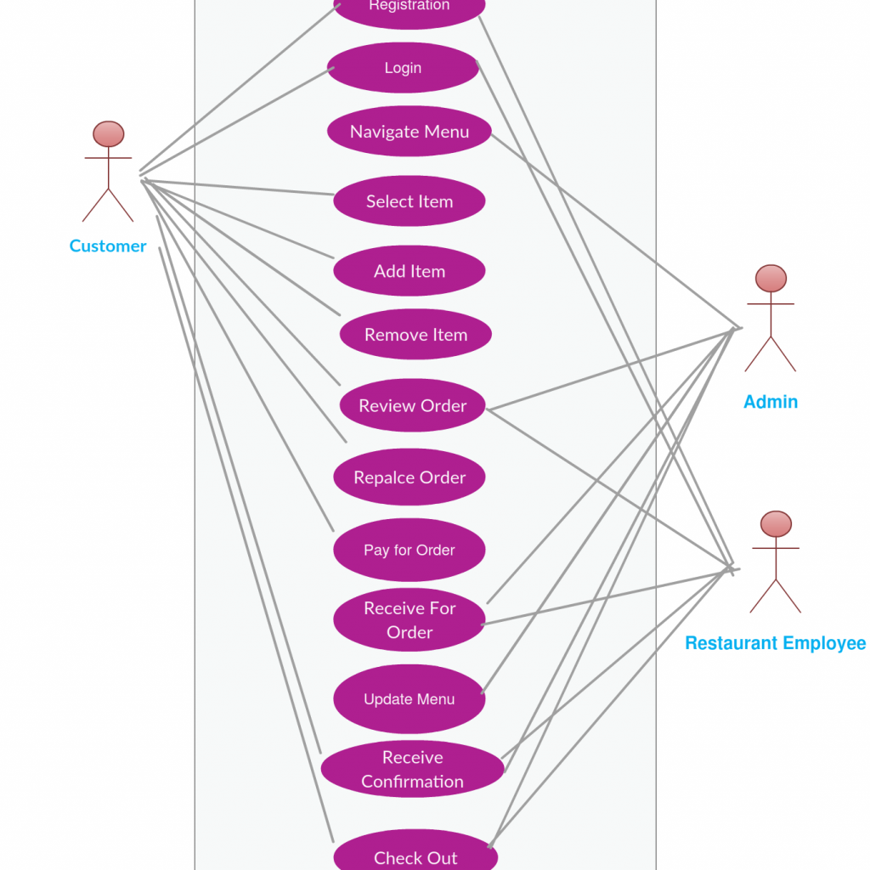
E-R Diagram for
Restaurant, Restaurant
Employee and Customer

Slide 8
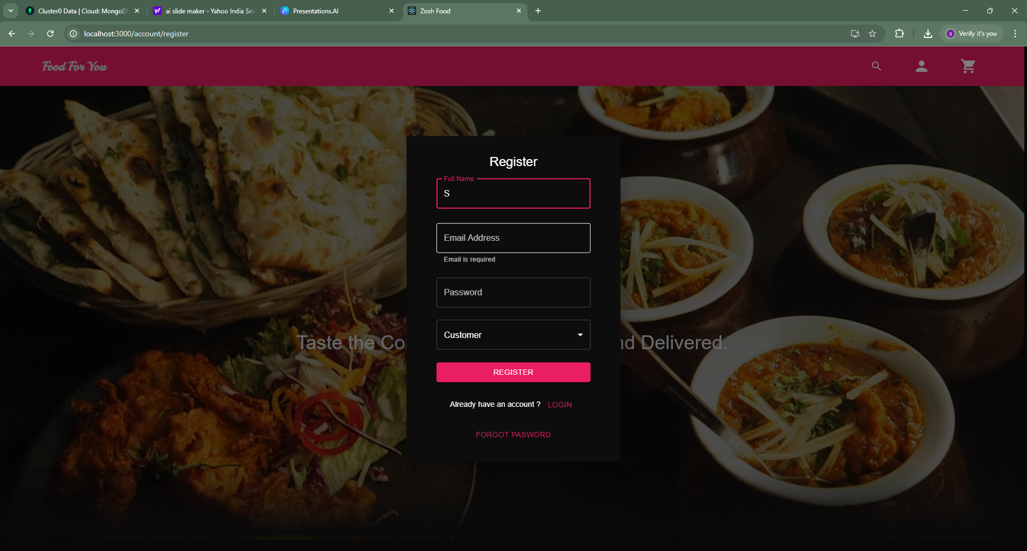
Registration Page For Customer and Restaurant

Slide 9
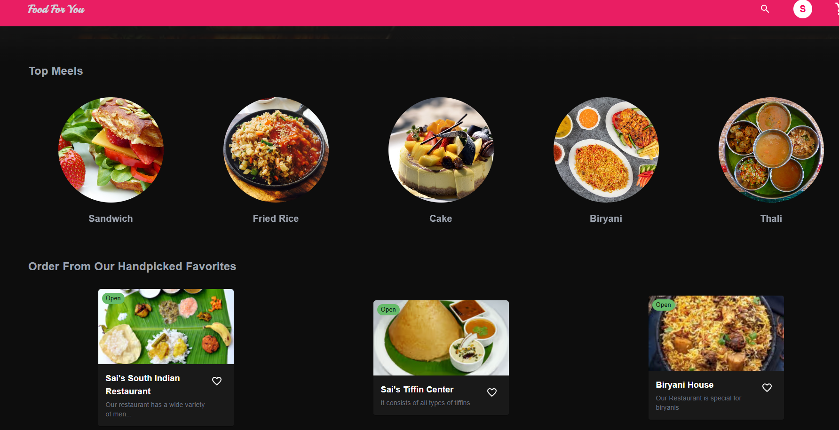
Home Page With Menu Items and Restaurants

Slide 10
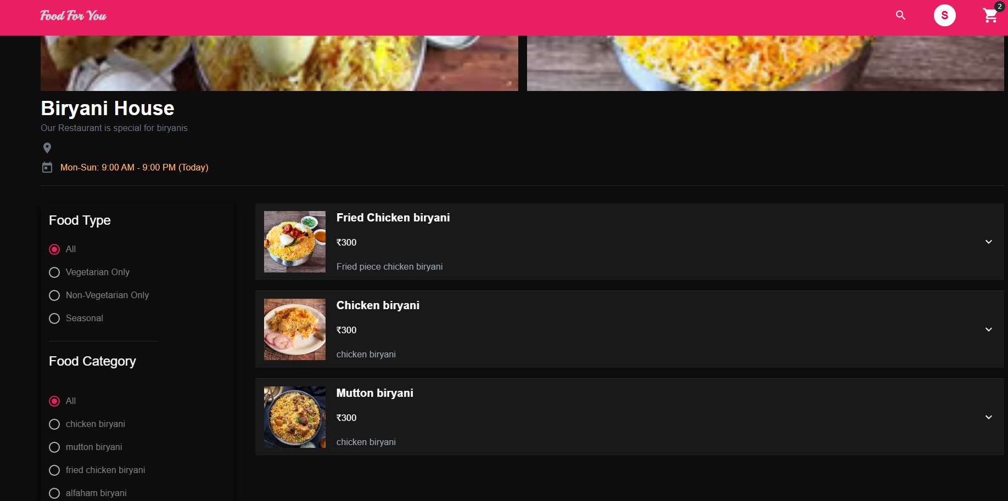
Dedicated Restaurant Page With Filter Functionality

Slide 11
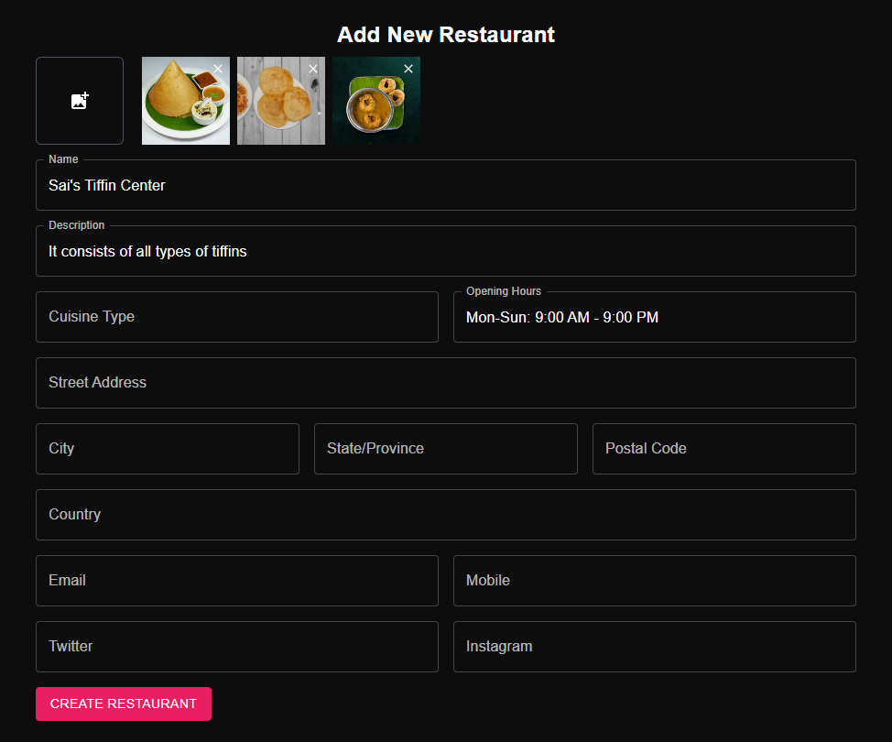
Adding Restaurant Info for the Existing User

Slide 12
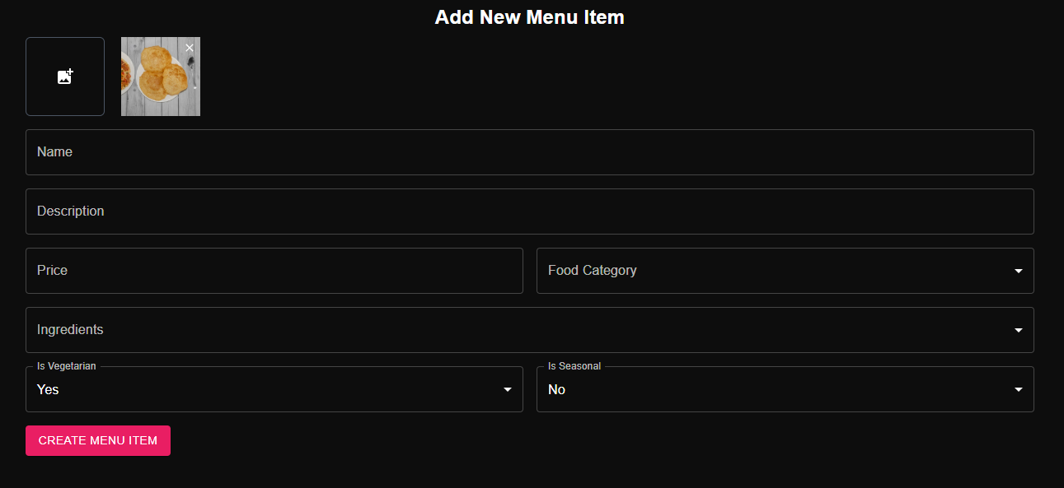
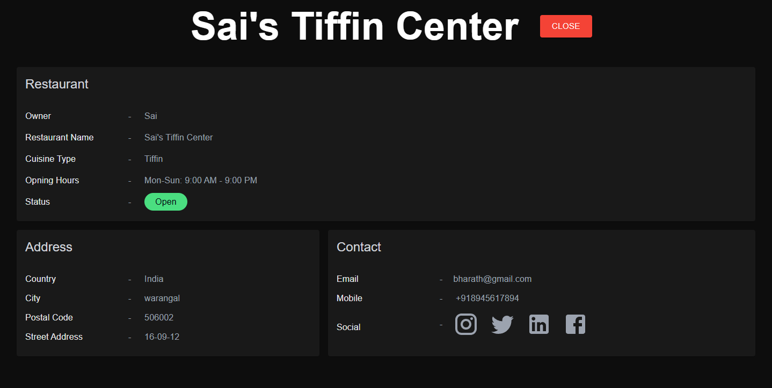
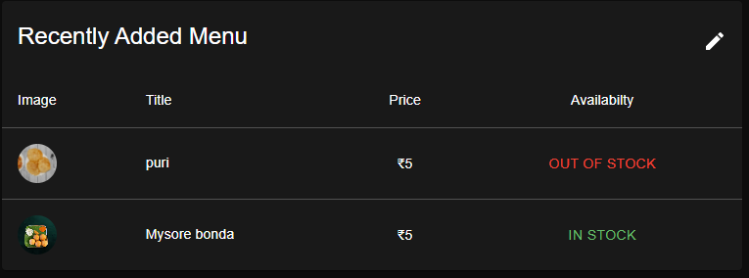
Adding New Menu Item
Adding New Menu Item
Added Menu Items

Slide 13
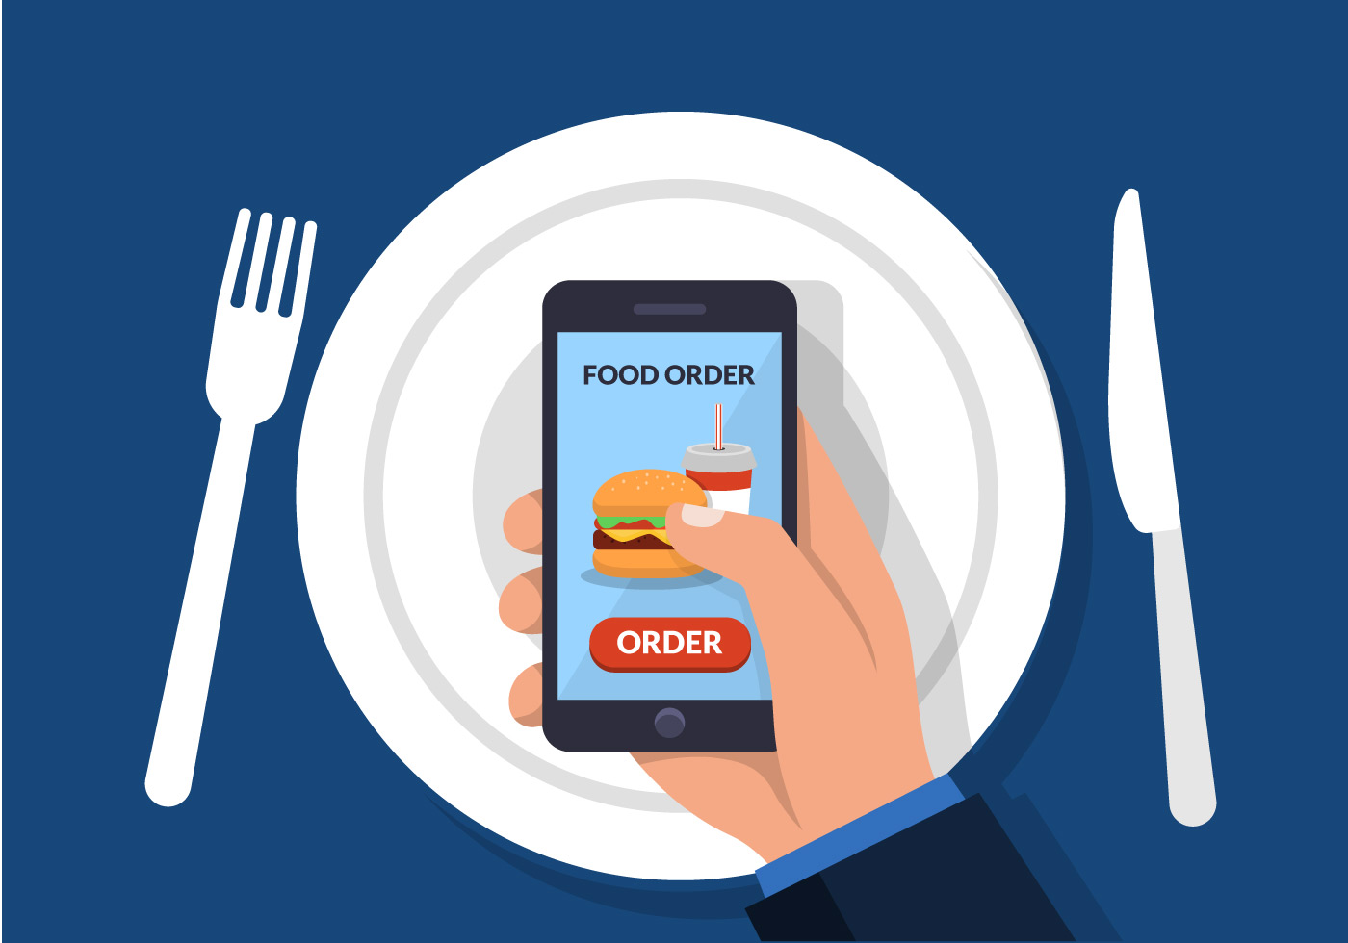
Conclusion
The Online Food Ordering App using the MERN stack provides an efficient, scalable, and user-friendly platform for food ordering, benefitting both customers and restaurant owners. By utilizing modern technologies like React and Node.js, the app ensures fast performance, real-time features, and a seamless experience for all users.
For customers, the app simplifies the food ordering process, improving convenience and reducing wait times, while the restaurant owners benefit from a streamlined order management system that helps increase efficiency and sales. The system also provides valuable customer insights, allowing for continuous improvement of services.
Ultimately, the MERN-based Online Food Ordering System combines cutting-edge technologies with a user-centered design to create a robust and efficient platform. It not only enhances customer satisfaction but also supports the growth and operational needs of restaurants, positioning the app as a competitive solution in the food delivery industry.

Slide 14


